Slide 1
Module 1-2
Introduction to the Course &
ARM Architecture

Slide 2
General Information
Course: EL 426 (DSA)
Instructor: Amit Bhatt
TAs: ?
Text books:
ARM assembly language by William Hohl
Computer Organization and Design by Patterson and Hennessey
Computer Architecture: A quantitative approach by Patterson and Hennessey
ARM System Developer’s Guide By Andrew N. Sloss, Dominic Symes, Chris Wright, Published by Elsevier (Optional)

Slide 3
Grading Policy (Tentative)
25% Midterm 1
25% Midterm 2
10% Lab performance
10% quiz / HW / Attendance
30% Final exam
Important: Attendance will be taken on some days. You need to attain 80% attendance in those days when attendance was taken. If you miss the quiz, then NO MAKEUP EXAM will be administered under any excuse. You will get zero marks

Slide 4
EL 426 Course Outline Digital System Architecture

Slide 5
Course Outline
Lecture 1:
Course outline, Grading policy, Goals and importance of the course
Lecture 2:
Explanation of the components of the processors
History of computers
How can a processor understand your program and concept of Instructions
Registers
Program counter
Memory / stored program concept
ALU
Pipelines

Slide 6
Lecture 3:
What is computer organization
Programmer's view vs. the Implementation details
Prevailing architectures
Modern day processor scenario
Lecture 4: (read Arm Assembly Language Ch.2)
ARM architecture
History
Versions
Relationship between architectural version number and processor family
ARM architecture programmers view (data types, number of registers, Program Status Register (PSR) and processor modes

Slide 7
Lecture 5: (Read AAL Ch 4, 5, 6,7)
Study of ARM ISA version 4T
Load/Store instructions
Arithmetical instructions
Logical instructions
Control instructions
Lecture 6: (Read AAL Ch 8, 10 and 14)
Loops and Branches
Subroutines and Stacks
ARM APCS
Passing parameters to subroutine
Mixing C and Assembly Language

Slide 8
Lecture 8: (Read AAL Ch 11)
Exception Handling
Lecture 9:
Revision
Lecture 10: (Read COD Ch 4.1, 4.2, 4.3, 4.4)
Logic design convention
Building a datapath
Lecture 11: (Read COD Ch 4.5)
Over view of Pipelining and Hazards
Lecture 12 & 13: (Read COD Ch 4.6)
Pipelined Datapath and control

Slide 9
Lecture 14:
Data Hazard (stalling vs forwarding)
Lecture 15:
Control Hazard
Branch Prediction; static and dynamic
Branch delay slot
Lecture 16 - 20 :
Exceptions in a pipelined processor
Concept of Instruction level parallelism (ILP)
Loop level parallelism (LLP)
Superscalar processor
VLIW processor

Slide 10
Lecture 20 – 23:
Memory hierarchy
Lecture 24 – 25
Multi-core processors
Up to five lectures will be used for in – class tutorial and quiz

Slide 11
ES – 215, Computer Organization…
What is Computer Organization?
It refers to the level of abstraction above the digital logic level, but below the operating system level
Major components are Processor, I/O system, Memory, Data Path and Control
Do I need ES 215 course? How will it help me in
Getting a job?
Higher Academic studies?

Slide 12
Where are the Processors?
How many Processors do you have in your house?

Slide 13
Mobile Phone (average 2.6 processors)
Tablet (more than 3)
Car (average 10 – 35)
iPod
Set top box for TV
microwave oven, washer, dryer, dishwasher, coffee maker, refrigerator, television, video-game console, stereo receiver, CD player, DVD player,remote control for the TV…

Slide 14
Number of Processor Sold World-wide?
Guess?

Slide 15
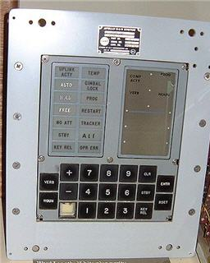


A little perspective…
Apollo 11’s Guidance Computer Specification: Designed at MIT and built by Raytheon; A rudimentary real time operating system ;

Slide 16
Apollo Guidance Computer, Block II (1965)
Memory (ROM): 36,864 words @ 16 bits (73,728 bytes) Memory (RAM): 2,048 words @ 16 bits (4,096 bytes) Clock Speed: 1 MHz Transistors: 16,800
Volume: 0.97 ft3 Weight: 70 lbs Power Consumption: 55 Watts

Slide 17

And now…
Samsung Galaxy S9 phone has
Octa-core (4x2.7 GHz Mongoose M3 & 4x1.8 GHz Cortex-A55) - EMEA Octa-core (4x2.8 GHz Kryo 385 Gold & 4x1.7 GHz Kryo 385 Silver) - USA/LATAM, ChinaHz
RAM: 4GB and HD 64GB – expandable to 256GB
State of the art graphics processor capable of rendering life like 3-D graphics
Mali-G72 MP18 - EMEA Adreno 630 - USA/LATAM, China
Good battery life of 9 hours of continuous video use

Slide 18
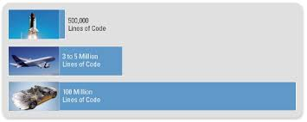
Relentless hunger for computing power…
Space shuttle
Boeing 787
Top segment Car
Premier Segment car now has 75 – 100 processor units
30% - 40% of the car price is due to electronics and related
software

Slide 19
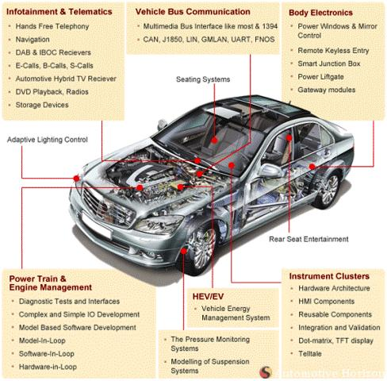

Slide 20
Historical view
Introduction of a new category
High Performance Computing (HPC)
Desktop/Laptop/Server Intel
Smartphones (MID)
Embedded System ARM
By 2015, MID market would be $29.9B

Slide 21
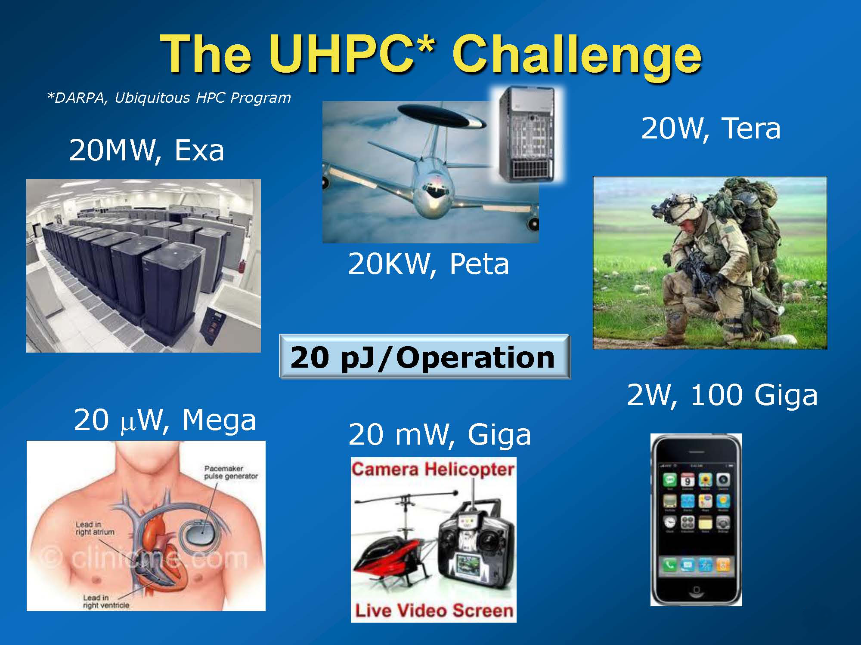

Slide 22
Software
Operating System, System software, Compiler
Computer Science
Instruction Set Architecture (ISA)
Register, Data path, I/O Control
Gate Level
Electronics / VLSI
Transistor Level
Device Physics Level

Slide 23
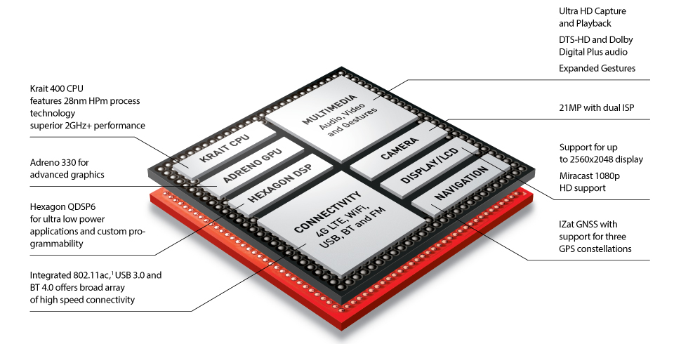

Slide 24
Programmer’s View Vs. Hardware Implementation
Programmer’s View:
Instruction Set Architecture
Number of Registers
Interrupt model
Implementation
Number of pipeline stages
Data Path and Control Path
Hidden registers
All other implementation strategies

Slide 25
Top 4 Mobile Phones
 | Model | Chipset | Processor | Instruction set Architecture
1 | Samsung Galaxy S4 | Exynos 5410 Octacore Or Qualcomm Snapdragon 600 | ARM Cortex A15 Quad Core,1.6 GHz, and ARM A7 1.2 GHz Quad Core Graphics IT SGX544MP3 | ARM v7A
2 | HTC One | Qualcomm Snapdragon 600 | Scorpian, Quad core 1.6GHz | ARM v7A
3 | Sony Xperia Z ultra | Qualcomm Snapdragon 800 | Krait 400 CPU Quad core, 2 GHz + Adrino 330 | ARM v7A
5 | Apple iPhone5 | Apple A6 | ARM Cortex A9, Dual core 1.3GHz, PowerVR SGX 543MP3 GPU | ARM v7A

Slide 26
ARM Architecture and Processor
An architecture defines behaviour that is common to many processor designs
This would include
The instruction set
Registers
Exception handling
Memory model
This is called “the Programmer’s View”

Slide 27
What is an Instruction and How it is executed?
Op Code
Destination
Source 1
Source 2
Stored Program Concept

Slide 28

ARM architecture
ARMv7-Cortex
x1-4
Cortex-A9
Cortex-A8
ARMv6
x1-4
ARM11 MPCore
ARM1176JZ(F)-S
ARM1156T2(F)-S
ARM1136J(F)-S
ARMv5
Cortex-R4F
ARM1026EJ-S
ARM968E-S
Cortex-R4
ARM926EJ-S
ARM946E-S
ARM966E-S
ARM7EJ-S
SC200
ARMv4
ARM920T
Cortex-M3
ARM922T
SC300
ARM7TDMI(S)
SC100
Cortex-M1
Notes:
An architecture defines behaviour that is common to many
processor designs.
The ARM architecture defines how an ARM processor must operate. This includes:
• the programmers model
• the instruction set
• system configuration
• exception handling
• the memory model.
A processor is an implementation of an architecture, and can be
integrated into several different designs

Slide 29
ARM Processor Naming Convention ARM{x}{y}{z}{T}{D}{M}{I}{E}{J}{F} – {S}
x: Family Name
y: Memory Management / Protection Unit
z: Cache
T: Thumb Instruction set
D: JTAG Debug Facility
M: Fast Multiplier
I: In Circuit Emulation (ICE)
E: Extended (Media related instructions), assumes TDMI
J: Jazzel
s: Synthesizable

Slide 30
Relative Performance*
mW/MHz
0.43
0.568
0.335
0.36
0.235
0.25
0.35
ARM926EJ-S
ARM1026EJ-S
ARM1136J-S
ARM1176JZ-S
ARM7TDMI
ARM920T
Cortex A8
*Represents attainable speeds in 130, 90 or 65nm processes

Slide 31
Details about ARM Architecture
It is a RISC based Architecture (Really?)
RISC vs CISC debate
Evolution of ARM architecture

Slide 32
ARM Architectural History
V4T | V5 | V6 | V7
Half word and Signed Half word support | Improved ARM – Thumb interworking | SIMD instructions | Thumb 2
System Mode | CLZ (count leading Zeros instruction) | Multiprocessing | NEON
Thumb Instruction set | Saturated Math | V6 Memory architecture | Trust Zone
 | DSP MAC instructions | Unaligned data support | Profiles: V7A (Applications) NEON V7R (RealTime) Hardware divide V7M (Microcontroler) Hardware divide Thumb-2 only
 | Extensions: Jazelle (V5TEJ) | Extensions: Thumb-2 (V6T2) Trustzone (V6Z) Multicore (V6K) Thumb Only (V6M)

Slide 33
How does a processor function
Remember the Stored Program Concept?
What is an instruction?
Types of Instruction in v4T
Load/Store
Miscellaneous
Data Operations
Change of Flow
MOV PC, Rm
Bcc
BL
BLX
Change of Flow

Slide 34
ARM pipelining Concept
ARM7TDMI
ARM decode
Reg
Read
Reg
Write
Instruction Fetch
Thumb→ARM decompress
Shift
ALU
Reg Select
FETCH
DECODE
EXECUTE
ARM9TDMI
ARM or Thumb Inst Decode
Instruction Fetch
Shift + ALU
Memory
Access
Reg
Write
Reg
Decode
Reg
Read
FETCH
DECODE
EXECUTE
MEMORY
WRITE
Notes:
Pipeline Comparison
The point of this foil is to show that with the ARM7TDMI a lot of work was carried out in the execute stage of the pipeline. Now with ARM9TDMI the execute stage has been split out into three stages to allow greater throughput.
This then means the CPI is about 1.5 compared against 1.9 for ARM7TDMI, and the operating frequency is approximately double for ARM9TDMI over ARM7TDMI on the same process. Therefore, at least double the processing power is available.
It is possible for the pipeline to interlock. Forwarding paths have been provided to minimise this as much as possible, but they can still occur. By using a bit of consideration when writing code they can almost be eliminated.

Slide 35
Data Sizes and Instruction Sets
The ARM is a 32-bit architecture
When used in relation to the ARM:
Byte means 8 bits
Halfword means 16 bits (two bytes)
Word means 32 bits (four bytes)
Most ARM’s implement two instruction sets
32-bit ARM Instruction Set
16-bit Thumb Instruction Set
Jazelle cores can also execute Java bytecode
Notes:
The cause of confusion here is the term “word” which will mean 16-bits to people with a 16-bit background.
In the ARM world 16-bits is a “halfword” as the architecture is a 32-bit one, whereas “word” means 32-bits.
Java bytecodes are 8-bit instructions designed to be architecture independent. Jazelle transparently executes most bytecodes in hardware and some in highly optimized ARM code. This is due to a tradeoff between hardware complexity (power consumption & silicon area) and speed.

Slide 36
ARM Instruction Address
Memory word
Inst 1
0
Byte 0
Byte 1
Byte 2
Byte 3
Inst 2
4
Byte 4
Byte 5
Byte 6
Byte 7
Inst 3
8
Byte 8
Byte 9
Byte 10
Byte 11
Inst 4
12
Byte 12
Byte 13
Byte 14
Byte 15
Inst 5
16
Byte 16
Byte 17
Byte 18
Byte 19
Inst 3
Inst 2
Inst 1
ARM decode
Reg
Read
Reg
Write
Instruction Fetch
Thumb→ARM decompress
Shift
ALU
Reg Select
FETCH
DECODE
EXECUTE

Slide 37
Concept of a Program Counter (PC)
Program counter is a special register which contains
the address of the instruction being fetched
ARM Instruction
PC
PC - 4
PC - 8
ARM decode
Reg
Read
Reg
Write
Instruction Fetch
Thumb→ARM decompress
Shift
ALU
Reg Select
FETCH
DECODE
EXECUTE
PC
PC - 2
PC - 4
Thumb Instruction
Notes:
Pipeline Comparison
The point of this foil is to show that with the ARM7TDMI a lot of work was carried out in the execute stage of the pipeline. Now with ARM9TDMI the execute stage has been split out into three stages to allow greater throughput.
This then means the CPI is about 1.5 compared against 1.9 for ARM7TDMI, and the operating frequency is approximately double for ARM9TDMI over ARM7TDMI on the same process. Therefore, at least double the processing power is available.
It is possible for the pipeline to interlock. Forwarding paths have been provided to minimise this as much as possible, but they can still occur. By using a bit of consideration when writing code they can almost be eliminated.

Slide 38
The ARM7TDMI Core details
ABE
A[31:0]
Address
Incrementer
Address Register
Incrementer
P
C
BIGEND
Register Bank
MCLK
PC Update
nWAIT
Instruction
Decoder
nRW
A
L
U
B
u
s
Decode Stage
MAS[1:0]
A
B
u
s
B
B
u
s
ISYNC
Multiplier
Instruction Decompression
nIRQ
nFIQ
and
nRESET
ABORT
Read Data Register
nTRANS
Barrel
Shifter
nMREQ
Control Logic
SEQ
LOCK
nM[4:0]
Write Data Register
nOPC
32 Bit ALU
nCPI
CPA
CPB
DBE
D[31:0]
Notes:
The ARM Core architecture
The ARM7 core is Von Neumann architecture i.e. instructions and data come in on one bus.
The core uses a LOAD and STORE architecture. i.e. all operations are on the registers. Data is loaded, executed upon and then stored back to memory as required. Block transfer: up to 16 register at once
The main feature of the ARM core is the data path. The data path is:-
Register Bank -> Barrel Shifter (on B bus) -> ALU -> Register Bank
Operations through the data path take one cycle. Consider a basic ADD instruction. ADD r0, r1, r2. The r1 and r2 are read out of the register bank on the A and B buses. The result is calculated in the ALU and written back to r0 via the ALU Bus. ( important: 2 read ports A and B! )
Consider an ADD instruction with a shift. ADD r0, r1, r2, LSL#2 The r1 and r2 are read out of the register bank on the A and B buses. R2 is shifted left by 2 in the barrel shifter, The result is calculated in the ALU as before, and written back to r0 via the ALU Bus.
The basic data path is completed in one cycle ( normally, if no delay due to multiply etc. ). In this cycle the following occurs:-
1) Read 2 operands from the register bank, one via the barrel shifter (to be shifted if required).
2) Implement a logical or arithmetic operation in the ALU.
3) Write back the result to register bank at the end of the cycle.
Can do shifts by a constant in the same cycle in ARM state, but not in Thumb state (where separate instructions are required to use the shifter). Limitation of reduced instruction space.
Instruction pipeline is three stage fetch -> decode -> execute.
Address Incrementer allows for burst mode addressing.
Booth multiplier has early termination if the rest of the operand is 0 or 1. The advantage is that it is small.
Notice the Thumb decompression stage on the instruction pipeline input. This uses a spare half clock cycle on the decode stage of the pipeline, and hence does not restrict the maximum clock speed over non-thumb ARM7’s.
For load operations, sign extension and/or rotation is done in the ALU. (ARM9 is different…see slide 21)

Slide 39
ARM and Thumb Performance
Dhrystone 2.1/sec
@ 20MHz
Memory width (zero wait state)
Notes:
Intention
To show a comparison of memory usage between ARM and thumb instructions when running from different size memory width.
In 16-bit memory, Thumb code is better. Even though there are more instructions, each instruction only take a single cycle to fetch whereas each ARM instruction now takes two cycles to fetch.
However you can see in the 16-bit example that the performance from Thumb has gone down -despite still taking a single cycle to fetch each instruction. This is because of data accesses, and in particular stack accesses. Even in Thumb, each access to the stack will be a 32-bit quantity (as register contents are transferred - and this lowers performance on a full 16-bit memory architecture.
One way around this is to provide a limited amount of 32-bit memory to place you stack in - which can give a useful performance boost. In this case the boost gets performance almost back to the full 32-bit performance level. The difference is due to the Dhrystone benchmark using integer (32-bit) global data which is still being stored in 16-bit wide memory.

Slide 40
The ARM Register Set
Current Visible Registers
Current Visible Registers
Current Visible Registers
Current Visible Registers
Current Visible Registers
Current Visible Registers
r0
r0
r0
r0
r0
r0
Abort Mode
r0
SVC Mode
Undef Mode
FIQ Mode
User Mode
IRQ Mode
r1
r1
r1
r1
r1
r1
r1
r2
r2
r2
r2
r2
r2
r2
Banked out Registers
Banked out Registers
Banked out Registers
Banked out Registers
Banked out Registers
r3
Banked out Registers
r3
r3
r3
r3
r3
r3
r4
r4
r4
r4
r4
r4
r4
r5
r5
r5
r5
r5
r5
r5
User
User
User
User
User
FIQ
FIQ
FIQ
FIQ
FIQ
FIQ
IRQ
IRQ
IRQ
IRQ
IRQ
IRQ
SVC
SVC
SVC
SVC
SVC
SVC
Undef
Undef
Undef
Undef
Undef
Undef
Abort
Abort
Abort
Abort
Abort
r6
Abort
r6
r6
r6
r6
r6
r6
r7
r7
r7
r7
r7
r7
r7
r8
r8
r8
r8
r8
r8
r8
r8
r8
r8
r8
r8
r8
r8
r9
r9
r9
r9
r9
r9
r9
r9
r9
r9
r9
r9
r9
r9
r10
r10
r10
r10
r10
r10
r10
r10
r10
r10
r10
r10
r10
r10
r11
r11
r11
r11
r11
r11
r11
r11
r11
r11
r11
r11
r11
r11
r12
r12
r12
r12
r12
r12
r12
r12
r12
r12
r12
r12
r12
r12
r13 (sp)
r13 (sp)
r13 (sp)
r13 (sp)
r13 (sp)
r13 (sp)
r13 (sp)
r13 (sp)
r13 (sp)
r13 (sp)
r13 (sp)
r13 (sp)
r13 (sp)
r13 (sp)
r13 (sp)
r13 (sp)
r13 (sp)
r13 (sp)
r13 (sp)
r13 (sp)
r13 (sp)
r13 (sp)
r13 (sp)
r13 (sp)
r13 (sp)
r13 (sp)
r13 (sp)
r13 (sp)
r13 (sp)
r13 (sp)
r13 (sp)
r13 (sp)
r13 (sp)
r13 (sp)
r13 (sp)
r13 (sp)
r13 (sp)
r13 (sp)
r13 (sp)
r13 (sp)
r13 (sp)
r13 (sp)
r14 (lr)
r14 (lr)
r14 (lr)
r14 (lr)
r14 (lr)
r14 (lr)
r14 (lr)
r14 (lr)
r14 (lr)
r14 (lr)
r14 (lr)
r14 (lr)
r14 (lr)
r14 (lr)
r14 (lr)
r14 (lr)
r14 (lr)
r14 (lr)
r14 (lr)
r14 (lr)
r14 (lr)
r14 (lr)
r14 (lr)
r14 (lr)
r14 (lr)
r14 (lr)
r14 (lr)
r14 (lr)
r14 (lr)
r14 (lr)
r14 (lr)
r14 (lr)
r14 (lr)
r14 (lr)
r14 (lr)
r14 (lr)
r14 (lr)
r14 (lr)
r14 (lr)
r14 (lr)
r14 (lr)
r14 (lr)
r15 (pc)
r15 (pc)
r15 (pc)
r15 (pc)
r15 (pc)
r15 (pc)
r15 (pc)
cpsr
cpsr
cpsr
cpsr
cpsr
cpsr
cpsr
spsr
spsr
spsr
spsr
spsr
spsr
spsr
spsr
spsr
spsr
spsr
spsr
spsr
spsr
spsr
spsr
spsr
spsr
spsr
spsr
spsr
spsr
spsr
spsr
spsr
spsr
spsr
spsr
spsr
spsr
spsr
spsr
spsr
spsr
spsr
Notes:
This animated slide shows the way that the banking of registers works. On the left the currently visible set of registers are shown for a particular mode.
On the right are the registers that are banked out whilst in that mode.
Each key press will switch mode:
user -> FIQ ->user -> IRQ -> user ->SVC -> User -> Undef -> User -> Abort and then back to user.
The following slide then shows this in a more static way that is more useful for reference

Slide 41
Program Status Registers
31
28
27
24
23
16
15
8
7
6
5
4
0
J
N Z C V Q
U n d e f i n e d
I F T mode
f
s
x
c
Condition code flags
N = Negative result from ALU
Z = Zero result from ALU
C = ALU operation Carry out
V = ALU operation oVerflowed
Sticky Overflow flag - Q flag
Architecture 5TE/J only
Indicates if saturation has occurred
J bit
Architecture 5TEJ only
J = 1: Processor in Jazelle state
Interrupt Disable bits.
I = 1: Disables the IRQ.
F = 1: Disables the FIQ.
T Bit
Architecture xT only
T = 0: Processor in ARM state
T = 1: Processor in Thumb state
Mode bits
Specify the processor mode
Notes:
Green psr bits are only in certain versions of the ARM architecture
ALU status flags (set if "S" bit set, implied in Thumb state).
Sticky overflow flag (Q flag) is set either when
saturation occurs during QADD, QDADD, QSUB or QDSUB, or
the result of SMLAxy or SMLAWx overflows 32-bits
Once flag has been set can not be modified by one of the above instructions and must write to CPSR using MSR instruction to cleared
PSRs split into four 8-bit fields that can be individually written:
Control (c) bits 0-7
Extension (x) bits 8-15 Reserved for future use
Status (s) bits 16-23 Reserved for future use
Flags (f) bits 24-31
Bits that are reserved for future use should not be modified by current software. Typically, a read-modify-write strategy should be used to update the value of a status register to ensure future compatibility. Note that the T/J bits in the CPSR should never be changed directly by writing to the PSR (use the BX/BXJ instruction to change state instead).
However, in cases where the processor state is known in advance (e.g. on reset, following an interrupt, or some other exception), an immediate value may be written directly into the status registers, to change only specific bits (e.g. to change mode).
New ARM V6 bits now shown.

Slide 42
Interrupts and Exceptions
External devices like Timer, USB interface, keyboard, mouse, audio input needs attention of the processor
Some internal events may also want to draw processor’s attention
Interrupts and exceptions are special kinds of control transfer, which means that they alter the normal program flow to handle external events or to report errors or exceptional conditions

Slide 43
Types of Interrupts and Exceptions
IRQ (Normal Interrupt)
FIQ (Fast Interrupt)
Reset
Undefined Instruction
Software Interrupt (SWI)
Prefetch abort (Instruction fetch memory abort)
Data abort (Data access memory abort)

Slide 44
Exception Priority
Reset
Data Abort
FIQ
IRQ
Prefetch Abort
SWI
Undefined Instruction
Highest
Lowest

Slide 45
Processor Modes
The ARM has seven basic operating modes:
User : unprivileged mode under which most tasks run
FIQ : entered when a high priority (fast) interrupt is raised
IRQ : entered when a low priority (normal) interrupt is raised
Supervisor : entered on reset and when a Software Interrupt instruction is
executed
Abort : used to handle memory access violations
Undef : used to handle undefined instructions
System : privileged mode using the same registers as user mode
Notes:
The Programmers Model can be split into two elements - first of all, the processor modes and secondly, the processor registers. So let’s start by looking at the modes.
Now the typical application will run in an unprivileged mode know as “User” mode, whereas the various exception types will be dealt with in one of the privileged modes : Fast Interrupt, Supervisor, Abort, Normal Interrupt and Undefined (and we will look at what causes each of the exceptions later on).
NB - spell out the word FIQ, otherwise you are saying something rude in German!
One question here is what is the difference between the privileged and unprivileged modes? Well in reality very little really - the ARM core has an output signal (nTRANS on ARM7TDMI, InTRANS, DnTRANS on 9, or encoded as part of HPROT or BPROT in AMBA) which indicates whether the current mode is privileged or unprivileged, and this can be used, for instance, by a memory controller to only allow IO access in a privileged mode. In addition some operations are only permitted in a privileged mode, such as directly changing the mode and enabling of interrupts.
All current ARM cores implement system mode (added in architecture v4). This is simply a privileged version of user mode. Important for re-entrant exceptions because no exceptions can cause system mode to be entered.

Slide 46
Relation between Exception type and Processor Mode
Exception Type | Processor Mode
Reset | Supervisor (SVC)
Undefined Instruction | Undef
Software Interrupt (SWI) | Supervisor (SVC)
Prefetch Abort | Abort
Data Abort | Abort
IRQ | IRQ
FIQ | FIQ

Slide 47
Exception Handling
When an exception occurs, the ARM:
Copies CPSR into SPSR_<mode>
Sets appropriate CPSR bits
Change to ARM state
Change to exception mode
Disable interrupts (if appropriate)
Stores the return address in LR_<mode>
Sets PC to vector address
To return, exception handler needs to:
Restore CPSR from SPSR_<mode>
Restore PC from LR_<mode>
This can only be done in ARM state.
0x1C
FIQ
0x18
IRQ
0x14
(Reserved)
0x10
Data Abort
0x0C
Prefetch Abort
0x08
Software Interrupt
0x04
Undefined Instruction
0x00
Reset
Vector Table
Vector table can be at 0xFFFF0000 on ARM720T and on ARM9/10 family devices
Notes:
Exception handling on the ARM is controlled through the use of an area of memory called the vector table. This lives (normally) at the bottom of the memory map from 0x0 to 0x1c. Within this table one word is allocated to each of the various exception types.
This word will contain some form of ARM instruction that should perform a branch. It does not contain an address.
Reset - executed on power on
Undef - when an invalid instruction reaches the execute stage of the pipeline
SWI - when a software interrupt instruction is executed
Prefetch - when an instruction is fetched from memory that is invalid for some reason, if it reaches the execute stage then this exception is taken
Data - if a load/store instruction tries to access an invalid memory location, then this exception is taken
IRQ - normal interrupt
FIQ - fast interrupt
When one of these exceptions is taken, the ARM goes through a low-overhead sequence of actions in order to invoke the appropriate exception handler. The current instruction is always allowed to complete (except in case of Reset).
IRQ is disabled on entry to all exceptions; FIQ is also disabled on entry to Reset and FIQ.

Slide 48
Home work
Read Chapter 2 and 3 from ARM Assembly Language book by William Hohl
Read Chapter 1 and 2 from ARM System Developer’s Guide
Download Keil software and play around with it. ( daiictpdc (10.100.56.21) ---> soft --> ARM)
ARM v4T instruction set is available in Appendix A from William Hohl’s book

Slide 49


